Slide 1

DAYANANDA SAGAR COLLEGE OF ENGINEERING Shavige Malleshwara Hills, Kumaraswamy Layout, Bangalore-560078 (An Autonomous Institute affiliated to VTU, Approved by AICTE &ISO 9001: 2008 Certified) Accredited by National Assessment & Accreditation Council (NAAC) with ‘A’ Grade Department of Mechanical Engineering
Batch Number 19
Major Project Phase 1- Presentation
Title: "Optimization and Characterization of Fused Deposition Modelling (FDM) Parameters for Enhanced Mechanical Properties in 3D Printed material for Biomedical application"
Guide Name | Dr. VIVEK BHANDARKAR. V. N
Designation | Asst. Professor
Student Name | Mallanna | Naveenakumar Annennanavar | Rakesha K P | Sudarshan N D
USN | 1DS20ME044 | 1DS20ME420 | 1DS21ME455 | 1DS21ME478

Slide 2
Abstract :
Additive manufacturing (AM) is the procedure in which parts are fabricated in a layer-by-layer manner, exactly the opposite of conventional manufacturing, in which material is removed. Nowadays, additive manufacturing is usually preferable over traditional manufacturing methods owing to its better accuracy, less time for manufacturing, lower cost, and good quality of products.
In Fused Deposition Modeling (FDM) three-dimensional (3D) printed part is greatly affected by the process parameters, therefore the parameters have to select properly to enhance the characteristics of the final product. The fused deposition modelling (FDM) technique is widely used to produce components for various applications and has the potential to revolutionize orthopaedic research through the production of custom-fit and readily available biomedical implants. The properties of FDM-produced implants are significantly influenced by processing parameters, with layer thickness being a crucial parameter. The effect of these parameters will be studied on tensile strength and flexural strength , experimentally and statistically.
The building parameters of three-dimensional (3D) printed composite bone plates will be optimized by an orthogonal experiment, and the effects of the layer thickness, printing speed, filament feeding speed, and biomedical content on the bending strengths and tensile strength of the specimens will be analysed. Based on Taguchi’s mixed model fractional factorial design(L27), experiments will be set and the specimens are printed on FDM 3D printer and tested for tensile strength and flexural strength. Thereafter, the optimal combination of the parameters will be selected using Signal-to-Noise ratio (S/N), and Analysis of Variance (ANOVA) is used for indicating the significant parameters and their effect on tensile strength and flexural strength.

Slide 3
Introduction:
Contrary to subtractive manufacturing, additive manufacturing (AM), often known as 3D printing, is a method of fabricating items by connecting data from 3D models, and it is typically carried out layer by layer. The design and manufacturing processes can be improved in terms of speed and flexibility due to this technology. Additionally, traditional manufacturing methods need a lot of time and money to generate complex shapes, therefore 3D printing machines are employed in many industries to create custom parts during the design phase. However, this technology's rapid progress resulted in the production of end-use components. The 3D printing technique can reduce wasteful material use, labor-intensive processes, and production costs. The final product's shape is set by a computer-aided design (CAD) file in this method, making design modification a effortless procedure. A important element of the fourth industrial revolution that reduces physical movement is 3D printing.
Numerous industries, including those in the automotive, aerospace, medical, food, clothing and fashion, electric and electronic, educational, prototype, architectural, chemical, building, and construction sectors, have applications in 3D printing technology. FDM, fused filament fabrication (FFF), stereolithography (SLA), direct jetting, photopolymer jetting, selective laser sintering (SLS), laser melting, electron beam melting, and hybrid processes are a few categories of AM. FDM technology is the most well-known of these 3D printer technologies since it is simple, affordable, and has a wide variety of commercially available raw materials. It can be used as a machine for continuous production and provides flexibility and friendliness in processing and material handling.

Slide 4
Introduction:
Utilizing additive manufacturing (AM) in orthopedics represents a primary application of this technology in the medical field, with a notable focus on personalized implants through 3D printing. Orthopedic implants include a range of applications, including trauma implants (such as plates and screws), spinal implants (e.g., artificial vertebral bodies and cages), joint implants (e.g., artificial hip and knee joints), as well as customized prostheses (e.g., scapular, chest, and rib prostheses), and scaffolds for bone tissue engineering.
Polylactic acid (PLA), a promising polymer due to its high biocompatibility and biodegradability, finds application in various biomedical contexts, including the creation of degradable scaffolds, bone plates, and other implants. However, non-degradable bone plates, made from materials like PLA, often require removal post-fracture healing, subjecting patients to additional surgeries. To address this, researchers have explored composite materials, incorporating bio ceramic particles like hydroxyapatite (HA), Polyether ether ketone (PEEK). These enhances implant biocompatibility, bone integration, and creates a slightly alkaline environment during degradation, reducing the risk of aseptic inflammation.

Slide 5
Literature survey :
1. Balwant Singh et. al., Through a comprehensive literature review, this research attempted to identify the various Polymer Matrix Composite (PMC) materials utilised in 3D printing. This study investigates the mechanical properties and other properties of composites created using 3D printing processes. And also, the influence of various composite materials and production procedures on mechanical characteristics has been compared. Hybrid materials can be employed to improve the end product's mechanical, tribological, and morphological qualities. The findings might serve as a model for future researchers interested in composite material development.
2. Xin Wang et. al., conducted research on polymer composite material 3D printing techniques such as fused deposition modelling, selective laser sintering, inkjet 3D printing, stereolithography, and 3D plotting. The technology for creating and performing particle, fiber, and nanomaterial-reinforced polymer composites is highlighted. They demonstrated the printability of the glass fibre and carbon fibre composite compositions created in this study using 3D models. They have also discussed potential applications in biomedical, electronics, and aerospace engineering.

Slide 6
3. Yahia Halabi et all, experimentally studied the process parameters namely fiber tensile strength, polymer tensile strength, layer thickness, fiber volume fraction, fiber form, infill pattern, and fiber orientation. MATLAB software was used to codify and implement the ABC algorithm and ANN modelling technique. The results shows that good accuracy of this model, R2 values for training, validation, and testing datasets were 0.96, 0.90, and 0.90, respectively; while the RMSE values for training, validation, and testing datasets were 26.71 Mpa, 41.72 Mpa, and 43.64 Mpa. e MAE values for training, validation, and testing datasets were 16.49 Mpa, 28.11 Mpa, and 27.11 Mpa.
4. Muammel M. Hanon et al., looked at the effect of different 3D printing processes on the tensile strength and hardness characteristics of PLA polymer. To create the testing specimens, the fused deposition modelling (FDM) approach was utilised with varied build orientation, raster direction angle, and layer height. Based on the performance obtained from the tested print conditions, a link between hardness and tensile strength was determined. The obtained findings demonstrate that the On-edge orientation samples had the greatest Young's modulus and ultimate tensile strength values of 1.896 ± 0.044 GPa and 49.12 ± 0.78 MPa, The 0.1 mm layer thickness specimen had the highest elongation at break (3.13%).

Slide 7
5. Christine Le et all studied the effect of layer thickness on the flexural properties of Polylactic Acid (PLA) bone plate implants produced by the FDM technique. Experimental results showed that the flexural strength is inversely proportional to the layer thickness due to the variation of voids in the specimens. A 3D finite element (FE) model was developed using Abaqus/Explicit software by incorporating the Gurson-Tvergaard (GT) porous plasticity model to predict the elastoplastic and damage behaviour of specimens with different layer thicknesses. It was shown that the FE model was able to predict the flexural behaviour of 3D-printed solid plates with a maximum error of 6.13% in the maximum load. The optimal layer height was found to be 0.1 mm, providing both high flexural strength and adequate bending stiffness.
6. Wenzhao Wang et all utilised the fused deposition modelling (FDM) technology to prepare the composite scaffolds of polylactic acid (PLA) and nano-hydroxyapatite (n- HA). The composite scaffold was optimized by material characterization, mechanical property test, and in vitro bone marrow mesenchymal stem cells biocompatibility test. Finally, a rabbit model was established to evaluate the osteogenic ability of PLA/n-HA scaffolds in vivo. The results indicated that the PLA/n-HA composites proposed in this study were highly printable, and the printed scaffold showed tunable mechanical strength accompanied by the proportion of n-HA components. The biocompatibility and osteogenic induction properties were proved better than that of the pure PLA scaffold.
7. Prairit Sharma et all studied the impact of significant parameters on the dimensional accuracy for different geometries such as cylindrical shafts, holes and rectangular slots. Predicting the dimensional variation is accomplished by using Decision Tree Machine Learning Algorithm. This algorithm's result is most suitable and provides accurate predictions; furthermore, the effectiveness of the model developed is validated by the R2 score of 0.67, the model can be further developed to establish industry-friendly functionality.

Slide 8
Objectives :
Modelling and 3D Printing the specimen using Fused Deposition Modeling (FDM).
To assess the mechanical properties like tensile strength, flexural strength and hardness of the 3D Printed specimen.
To investigate the microstructural characteristics of the 3D Printed specimen.
To arrive at an empirical relation to assess the output response’s tensile strength and flexural strength in 3D printing of the Specimen.
To experimentally investigate the process attributes for 3D Printing of specimen and identify the optimum process parameters using Response Surface Methodology (RSM) and Artificial Neural Network (ANN) approach.
To select the optimum combination of parameters using Signal-to-Noise ratio (S/N), and Analysis of Variance (ANOVA) is used for indicating the significant parameters and their effect on tensile strength and flexural strength.

Slide 9
Flow chart :
Literature survey
Material selection
Modelling
3D printing
Assess the mechanical properties
Optimization of process parameters using RSM and ANN
Conclusion

Slide 10
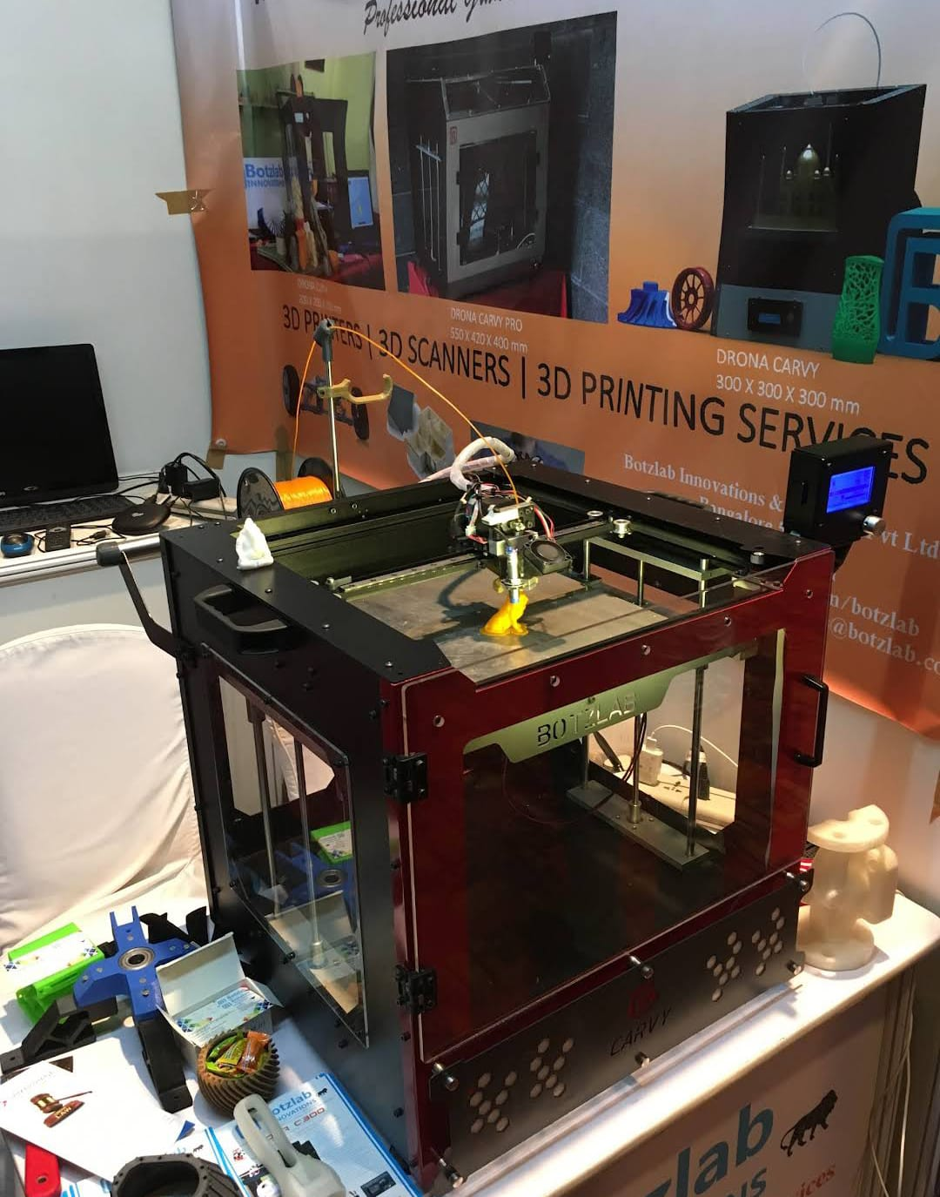
Specification of FDM
Build Volume | 260 x 260 x 260 mm
Layer Resolution | Down to 50 microns
Nozzle Diameter | 0.4 mm (Standard)
Max Nozzle Temperature | Up to 450°C
Max Bed Temperature | Up to 160°C
Print Speed | Up to 300 mm/s
Compatible materials | PEEK, Nylon, Carbon Fiber, PEKK, PPSU, TPU, PC, PLA, ABS.

Slide 11
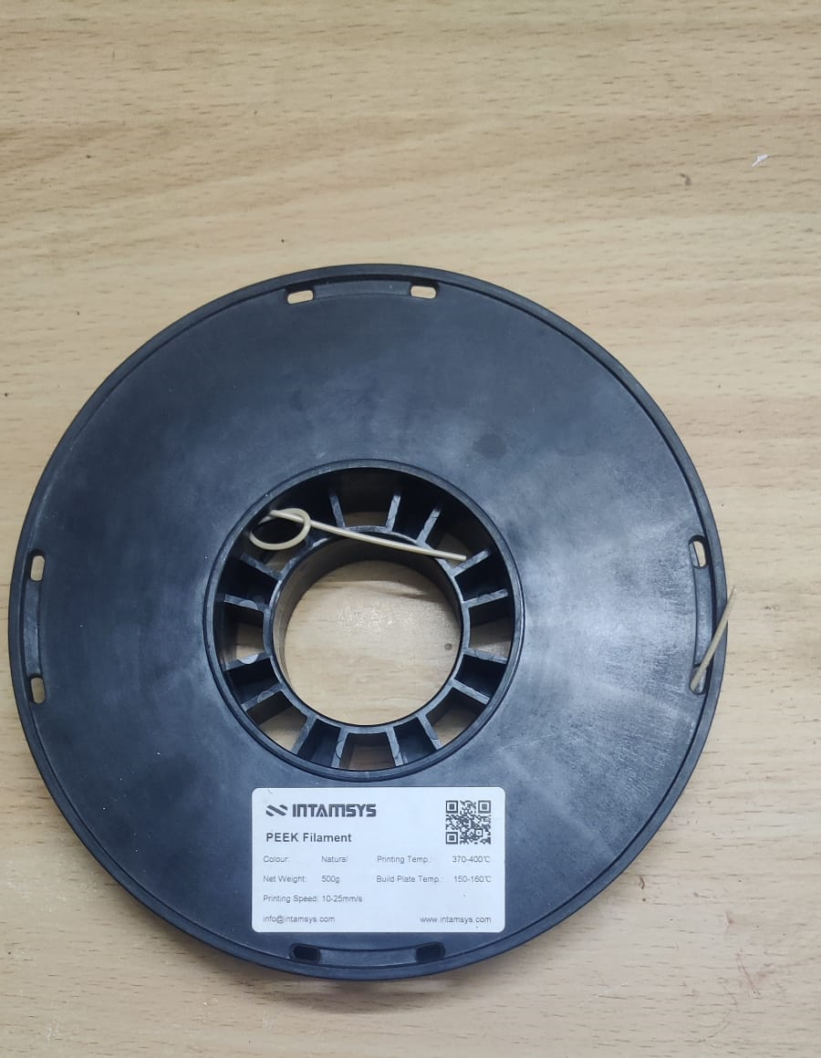
Specification of material: Polyetheretherketone [PEEK]
Chemical Structure | PEEK belongs to the family of polyaryletherketones. Chemical formula: C₁₉H₁₂O₃C₁₉H₁₂O₃
Physical Properties | Density: 1.3 g/cm³ Melting Point: 343°C - 387°C Glass Transition Temperature (T_{g}): 143°C
Mechanical Properties | Tensile Strength: 90 - 100 MPa Flexural Strength: 140 - 160 MPa Hardness (Rockwell): 99 HRM
Thermal Properties | Thermal Conductivity: 0.25 W/m-K Coefficient of Thermal Expansion: 40 - 60 µm/m-K

Slide 12
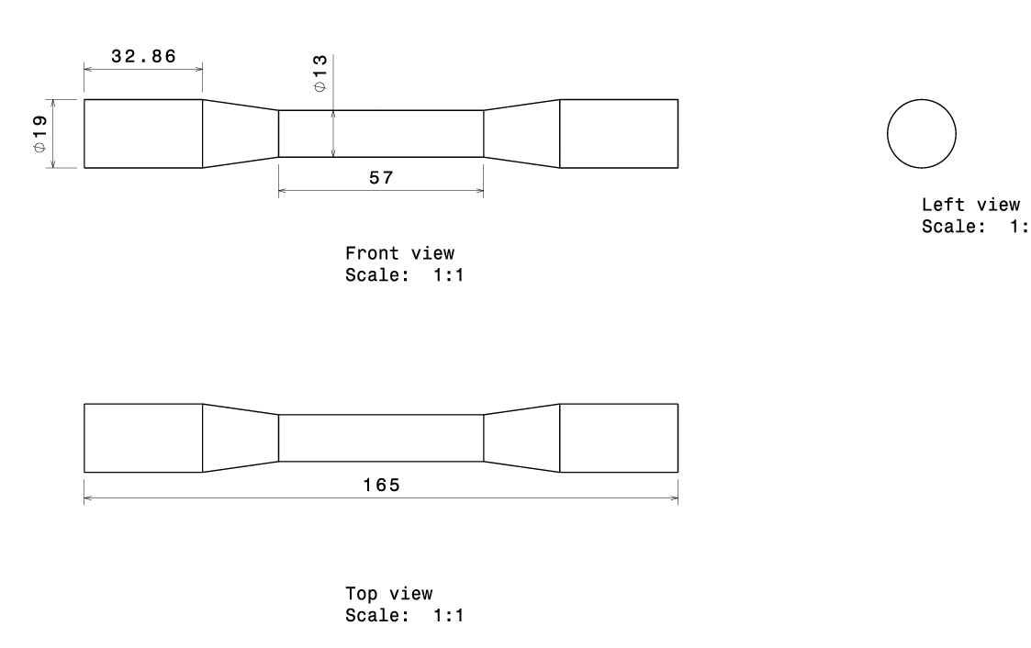
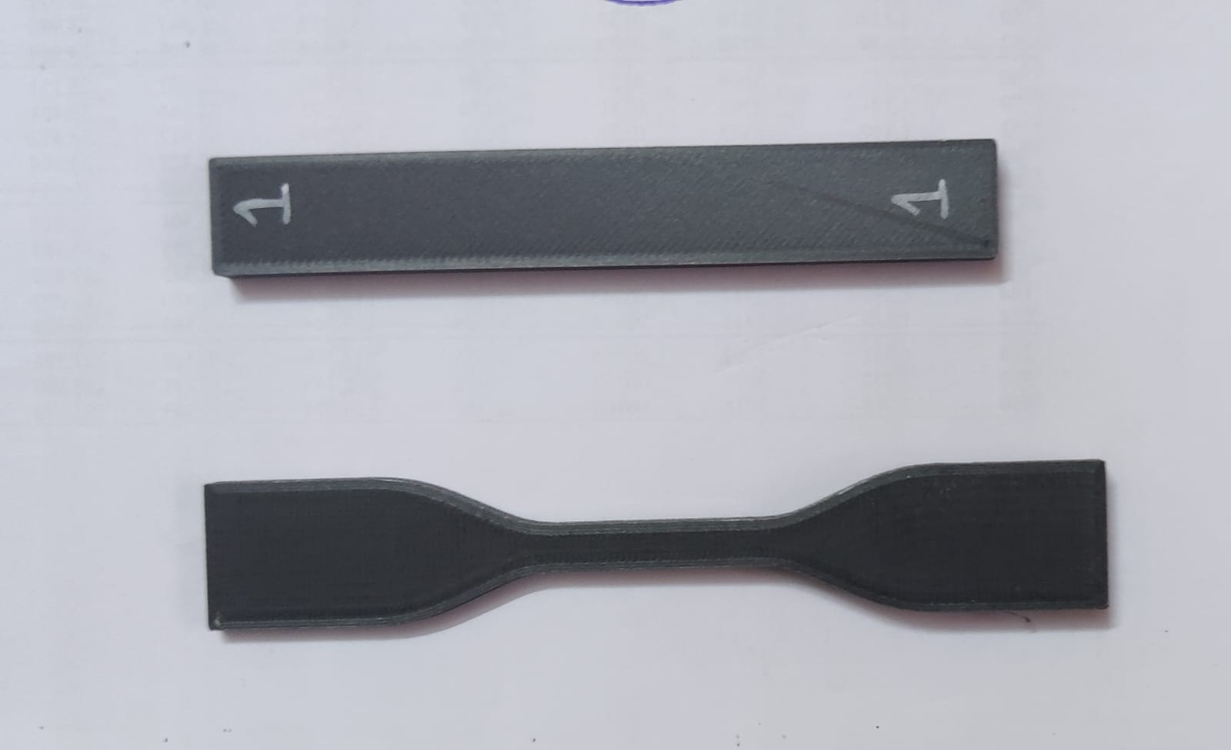
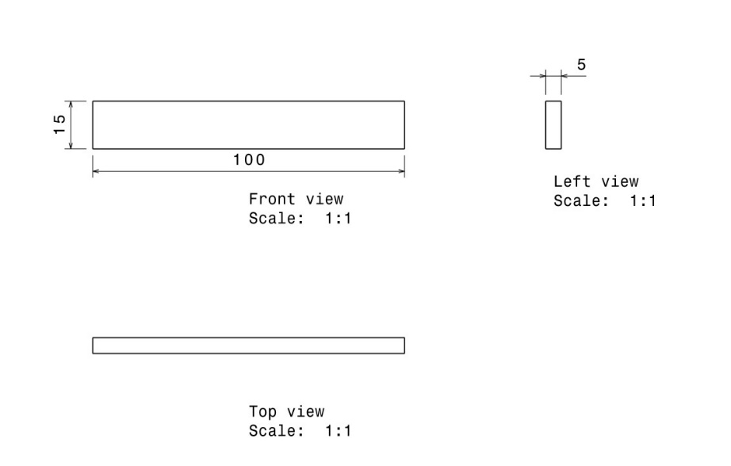
MODELING
Test Method | Method number
Tensile test | ASTM D638
Flexural test | ASTM D7264
Tensile Test Specimen
Flexural Test Specimen

Slide 13
Applications:
Patient-Specific Implants.
Orthopaedic Implants.
Trauma Surgery.
Research and Development.
Customized Surgical Guides.

Slide 14
EXPECTED OUTCOME OF THE PROJECT
Improved tensile strength, flexural strength, and hardness of the 3D printed PEEK materials.
Identification and control of microstructural features to ensure uniformity.
Detailed documentation of the optimized FDM parameters and characterization results.
Materials specifically tailored for biomedical applications, addressing the unique requirements of the healthcare industry.
The optimization and characterization of FDM parameters for 3D printed material for Biomedical application aim to achieve superior mechanical properties, biocompatibility, and cost-effectiveness, ultimately advancing the field of additive manufacturing in the biomedical industry.

Slide 15
References
[1] Balwant Singh, Raman Kumar, “Polymer matrix composites in 3D printing: A state of art review” https://doi.org/10.1016/j.matpr.2020.04.335
[2] Xin Wang, Man Jiang, “3D printing of polymer matrix composites: A review and prospective”
https://doi.org/10.1016/j.compositesb.2016.11.034
[3] Yahia Halabi, “Optimizing the material and printing parameters of the additively manufactured fiber-reinforced polymer composites using an artificial neural network model and artificial bee colony algorithm”
https://doi.org/10.1016/j.istruc.2022.10.134
[4] Muammel M. Hanon, “The influence of 3D printing process parameters on the mechanical performance of PLA polymer and its correlation with hardness” https://www.elsevier.com/locate/jmbbm
[5] Christine Le, “Experimental and numerical investigation of 3D-Printed bone plates under four-point bending load utilizing machine learning techniques” www.elsevier.com/locate/jmbbm
[6] Wenzhao Wang, “3D printing of PLA/n-HA composite scaffolds with customized mechanical properties and biological functions for bone tissue engineering” www.elsevier.com/locate/jmbbm
[7] Prairit Sharma, “Experimental and numerical investigation of 3D-Printed bone plates under four-point bending load utilizing machine learning techniques” www.elsevier.com/locate/jmbbm

